Slide 1


Deep Content-Level Analysis of Robotics Datasets and Instructions
A comprehensive exploration of data modalities, annotations, and actionable insights
May 30, 2025

Slide 2






Objective and Methodology
Research Objective
• Perform deep, content-level exploration of robotics datasets
• Understand actual data content beyond surface-level descriptions
• Identify patterns, gaps, and opportunities for dataset repurposing
• Analyze language-to-function mapping in robot instruction datasets
Methodology
In-depth analysis of 11 diverse robotics datasets
Evaluation of dataset scale and coverage
Examination of raw data types and formats
Analysis of 20-30 robot instruction samples
Assessment of annotation structures
Synthesis of actionable insights

Slide 3














Exploring Awesome Robotics Datasets
Resource Overview
Exploration Approach
mint-lab/awesome-robotics-datasets
For each selected dataset:
is a curated collection of robotics datasets organized by:
Identify raw data types and formats
Driving (autonomous vehicles)
Examine annotation structures
Flying (drones, MAVs)
Assess scale and coverage
Underwater (marine robotics)
Analyze concrete examples
Indoor (navigation, mapping)
Identify unique modalities
Outdoor (terrain, localization)
Evaluate repurposing potential
Topic-specific (manipulation, etc.)
Selected Datasets for Deep Analysis
KITTI Vision Benchmark
Waymo Open Dataset
nuScenes Dataset
Zurich Urban MAV Dataset
ACFR Marine Robotics
Ford Campus Dataset
New College Dataset
MIT Stata Center Dataset
RGB-D Dataset 7-Scenes

Slide 4














Deep Dive: KITTI Vision Benchmark
Raw Data
Annotations & Ground Truth
Cars, pedestrians, cyclists with orientation
Stereo Cameras:
2 × PointGrey Flea2 (1.4MP, grayscale)
3D Bounding Boxes:
Color Camera:
2 × PointGrey Flea2 (1.4MP, color)
Object Tracking:
Consistent IDs across frames
Lidar:
Velodyne HDL-64E (64 beams, 10Hz)
Semantic Segmentation:
Pixel-level class labels
GPS/IMU:
OXTS RT3003 (6-axis, 100Hz)
Optical Flow:
Dense motion fields
Platform:
Volkswagen Passat B6
Depth Maps:
Stereo-derived depth
Scale
Odometry:
Precise vehicle trajectory
6 hours of traffic scenarios
Concrete Examples
Urban, rural, highways
~15,000 annotated frames
File Structure:
Organized by date and drive number
~200,000 3D objects labeled
3D Box Format:
[x,y,z,l,w,h,ry] with class and occlusion
Calibration:
Detailed matrices for all sensors
Unique Modalities & Focus
Benchmark Suite:
Multiple tasks in one dataset
Diverse Environments:
Urban, highway, country roads
Synchronized Multi-Modal:
All sensors precisely time-aligned
Rich Annotations:
Multiple ground truth types

Slide 5




Deep Dive: Waymo Open Dataset
Raw Data
Annotations & Ground Truth
Vehicles, pedestrians, cyclists with tracking IDs
Lidars:
5 × Lidars (1 mid-range top, 4 short-range perimeter)
3D Bounding Boxes:
Cameras:
5 × high-resolution cameras (front, sides, rear)
2D Bounding Boxes:
Aligned with camera frames
Audio:
Synchronized audio recordings
22 classes (road, sidewalk, vehicles, etc.)
Semantic Segmentation:
Platform:
Waymo autonomous vehicles
Scale
Motion:
Predicted trajectories
1,000+ driving segments
Scene Flow:
Point-level motion vectors
20+ seconds each segment
Concrete Examples
Diverse locations, times, weather
Data Format:
TFRecord files with protocol buffers
Millions of 3D bounding boxes
3D Box Format:
[center_x, center_y, center_z, length, width, height, heading]
12+ million 2D labels
Segmentation:
Per-point semantic labels in Lidar data
Unique Modalities & Focus
Multi-Lidar Setup:
5 Lidars for 360° coverage
Scene Flow:
Point-level motion estimation
Audio Integration:
Rare in autonomous driving datasets
Diverse Conditions:
Day/night, various weather, multiple cities

Slide 6




Deep Dive: nuScenes Dataset
Raw Data
Annotations & Ground Truth
Lidar:
1 × 32-beam Lidar (20Hz)
3D Bounding Boxes:
23 classes with attributes
Cameras:
6 × cameras for 360° coverage
Object Tracking:
Consistent IDs across frames
Radar:
5 × radar sensors
Semantic Maps:
Road geometry, lane markings
GPS/IMU:
High-precision localization
Object Attributes:
Visibility, activity, pose
Platform:
Vehicle with roof-mounted sensor suite
HD Maps:
Drivable areas, walkways, etc.
Scale
Concrete Examples
1,000 scenes (20s each)
Data Structure:
Scenes → Samples → Data (sensor readings)
Boston and Singapore
3D Box Format:
[x,y,z,w,l,h,θ] with velocity, attributes
Day/night, various weather
Map Data:
Vector layers for lanes, boundaries, etc.
1.4M 3D bounding boxes
23 object classes
Unique Modalities & Focus
Radar Integration:
Uncommon in most datasets
Multi-City:
Cross-cultural driving environments
Rich Attributes:
Detailed object state descriptions
HD Maps:
Detailed semantic map layers

Slide 7








Deep Dive: Zurich Urban MAV Dataset
Raw Data
Annotations & Ground Truth
Stereo Camera:
Synchronized stereo image pairs
Pose Ground Truth:
6-DOF trajectory
IMU:
ADIS16448 IMU (3-axis accel/gyro)
Calibration:
Camera intrinsics/extrinsics
Event Camera:
Dynamic Vision Sensor (DVS)
Time Synchronization:
Precise timestamps
Platform:
Micro Aerial Vehicle (MAV)
Reference Data:
Leica position measurements
Scale
Concrete Examples
Urban environment (Zurich)
Data Format:
ROS bag files
Multiple flight trajectories
Image Format:
Grayscale stereo pairs
Several minutes per sequence
Event Data:
Asynchronous pixel-level brightness changes
20Hz stereo images
Ground Truth:
CSV files with timestamped poses
200Hz IMU data
Unique Modalities & Focus
Aerial Perspective:
Data from flying platform
Urban Environment:
Complex structures, varied textures
Event Camera:
High dynamic range, low latency
MAV Focus:
Designed for aerial robotics research

Slide 8



Deep Dive: ACFR Marine Robotics Datasets
Raw Data
Annotations & Ground Truth
Sonar:
Multibeam and sidescan sonar
SLAM Maps:
Underwater terrain reconstructions
Stereo Camera:
Underwater stereo vision
Vehicle Trajectory:
AUV pose estimates
DVL:
Doppler Velocity Log
Habitat Labels:
Expert-annotated species/substrate
IMU:
Inertial measurement unit
Calibration:
Sensor calibration parameters
Platform:
Autonomous underwater vehicles (AUVs)
Concrete Examples
Scale
Data Format:
Mission-specific log files
Multiple underwater sites
Sonar Data:
Raw acoustic returns and processed bathymetry
Various AUV missions
Image Data:
Underwater stereo imagery with visibility challenges
Hours of underwater navigation
Navigation:
Fused DVL/IMU/GPS (when surfaced) data
Diverse underwater environments
Benthic habitat surveys
Unique Modalities & Focus
Underwater Domain:
Challenging visibility, refraction
Marine Biology:
Habitat mapping and classification
Acoustic Sensing:
Primary underwater perception
3D Navigation:
Full 6-DOF underwater movement

Slide 9

Deep Dive: Ford Campus Vision and Lidar Data Set
Raw Data
Annotations & Ground Truth
Lidar:
Velodyne HDL-64E (64 beams)
Ground Truth Poses:
High-accuracy vehicle trajectory
Cameras:
Point Grey Ladybug3 omnidirectional camera
Calibration:
Sensor extrinsics and intrinsics
GPS/IMU:
Applanix POS-LV 420 INS
Time Synchronization:
Precise timestamps
Platform:
Ford F-250 pickup truck
Loop Closures:
Same locations revisited
Scale
Concrete Examples
Ford Research campus and downtown Dearborn
Data Format:
Log files with timestamps
Multiple loops of the same environment
Lidar Data:
3D point clouds (x,y,z,intensity)
Data collected over different days/seasons
Image Data:
Panoramic images from Ladybug3
~70 km of urban and campus roads
Ground Truth:
Precise pose from Applanix INS
Unique Modalities & Focus
Long-Term Autonomy:
Same routes over different times
High-Precision INS:
Accurate ground truth
Omnidirectional Vision:
360° camera coverage
Loop Closure Focus:
Ideal for SLAM evaluation

Slide 10



Deep Dive: Newer College Dataset
Raw Data
Annotations & Ground Truth
Config 1 (2020):
Intel Realsense D435i (stereo+IMU)
Ground Truth Poses:
Centimeter-accurate 6-DOF
Config 1 (2020):
Ouster OS-1 64-beam Lidar
Static Map:
BLK360 survey-grade scan (290M points)
Config 2 (2021):
Alphasense Core (4-camera)
Calibration:
Sensor extrinsics
Config 2 (2021):
Ouster OS-0 128-beam Lidar
Time Synchronization:
Precise timestamps
Platform:
Handheld rig at walking speed
Concrete Examples
Scale
Data Format:
ROS bag files
New College, Oxford environment
Topics:
Lidar points, stereo/multi-camera images, IMU
~6.7 km total trajectory
Ground Truth:
Generated by aligning Lidar scans to static map
Built environments, open spaces, vegetation
Organization:
Multiple sequences with train/test splits
Challenging sequences (fast motion, lighting changes)
Unique Modalities & Focus
High-Precision Ground Truth:
Centimeter-accurate poses
Modern Sensors:
High-resolution Lidars, multi-camera
Handheld Platform:
Natural motion dynamics
Challenging Conditions:
Fast motion, lighting changes

Slide 11





Deep Dive: MIT Stata Center Dataset
Raw Data
Annotations & Ground Truth
Lidars:
2 × Hokuyo UTM-30LX (base, tilt)
Ground Truth Poses:
2-3 cm accuracy
Cameras:
Wide baseline stereo OR Microsoft Kinect
Building Models:
As-built floorplans (XML)
IMU:
Microstrain 3DM-GX2
3D Models:
Occupancy maps, PLY, RWX formats
Odometry:
Wheel encoders (raw and EKF)
Calibration:
Sensor extrinsics
Platform:
PR2 robot
Concrete Examples
Scale
Data Format:
ROS bag files
10-story academic building (67,000 m²)
Topics:
/base_scan, /tilt_scan, /robot_pose_ekf/odom_combined
42 km total distance (as of 2012)
Ground Truth:
Generated via scan matching to floorplans
38 hours of data (as of 2012)
Organization:
Experiments with size, duration, distance
~2.3 TB total size (as of 2012)
Multi-year collection (2011-2013)
Unique Modalities & Caveats
Long-Term Indoor:
Multi-year, same environment
Vast Scale:
One of the largest indoor datasets
Multi-Floor:
10-story building coverage
Note:
Dataset marked inactive, has consistency issues

Slide 12








Deep Dive: RGB-D Dataset 7-Scenes
Raw Data
Annotations & Ground Truth
RGB-D Camera:
Microsoft Kinect v1
Camera Poses:
6-DOF ground truth for every frame
Color Images:
640×480 RGB (24-bit PNG)
3D Model:
TSDF volumes (512×512×512)
Depth Images:
640×480 depth in mm (16-bit PNG)
Train/Test Splits:
Predefined evaluation splits
Principal point (320,240), Focal length (585,585)
Platform:
Handheld Kinect
Default Intrinsics:
Scale
Concrete Examples
7 distinct indoor scenes
File Naming:
Multiple sequences per scene
frame-XXXXXX.color.png, frame-XXXXXX.depth.png
Different users recording each scene
Pose Format:
4×4 camera-to-world matrix (frame-XXXXXX.pose.txt)
500-1000 frames per sequence
Tens of thousands of total frames
TSDF Format:
MetaImage format (header + binary data)
Organization:
One zip file per scene with multiple sequences
Unique Modalities & Focus
Relocalization Focus:
Designed for camera pose estimation
Handheld Capture:
Natural motion patterns
KinectFusion Ground Truth:
Dense reconstruction-based poses
Indoor Scenes:
Varied environments (office, kitchen, stairs)

Slide 13

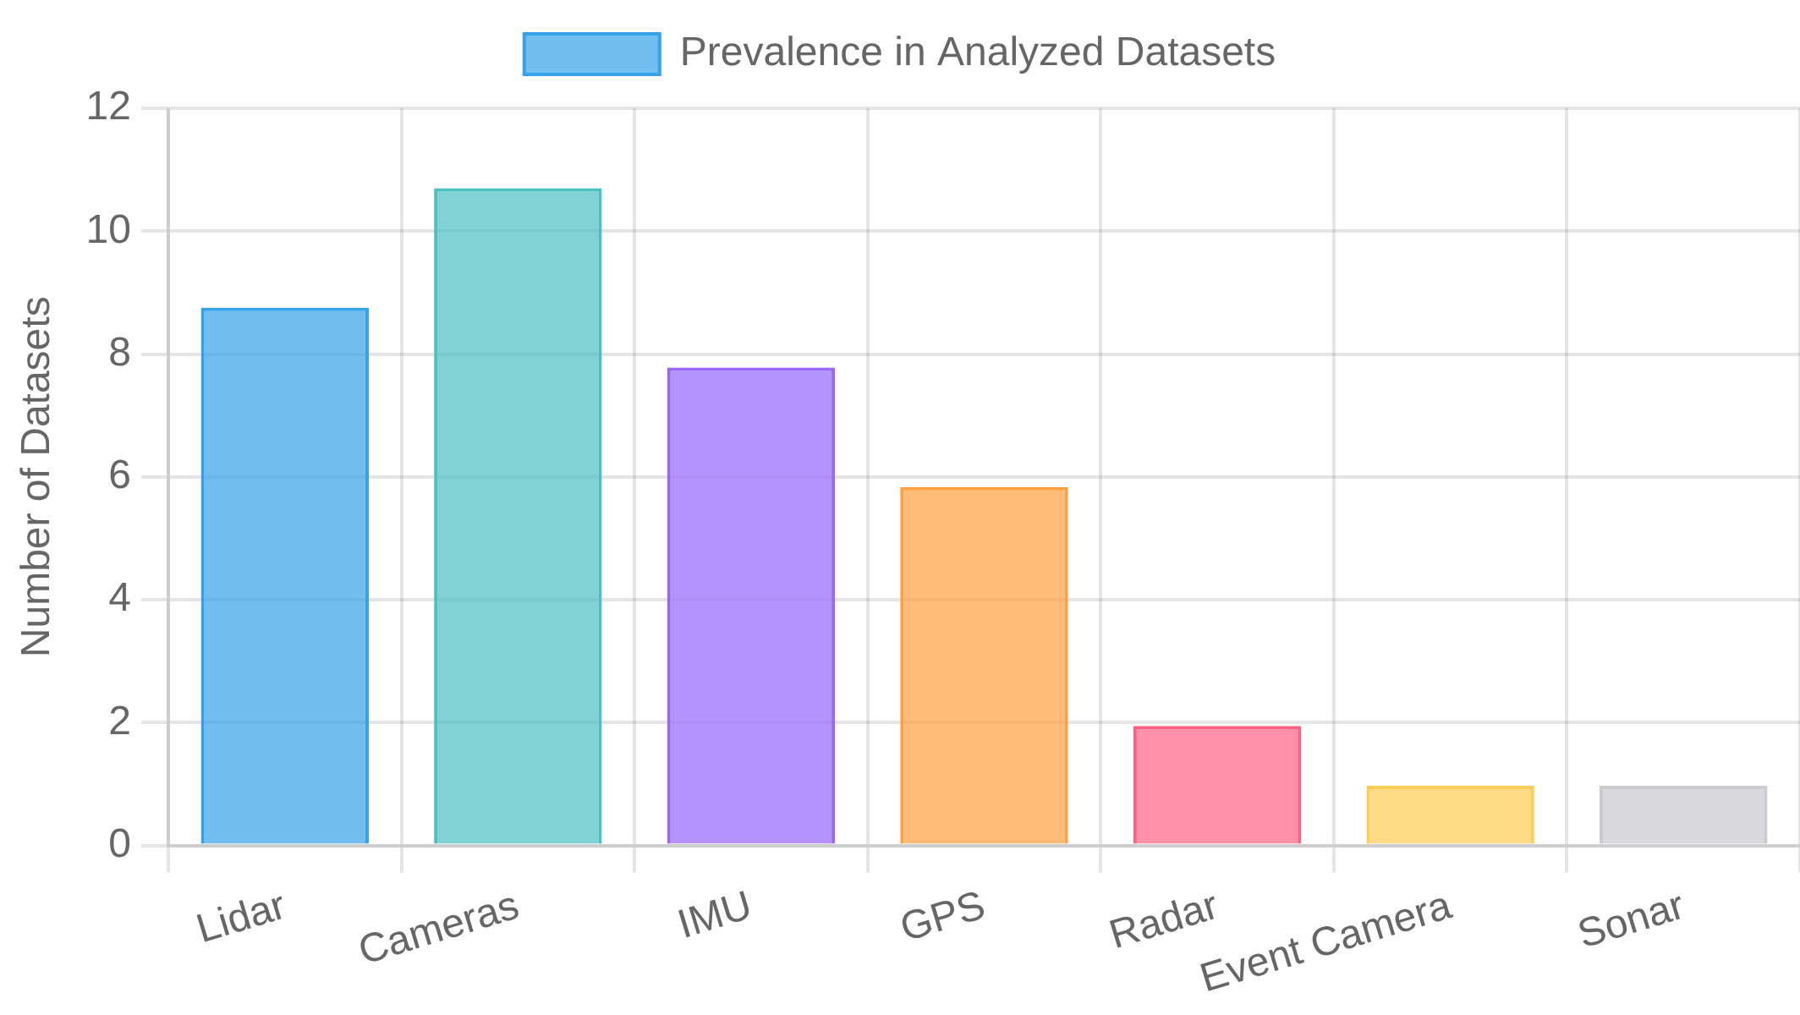
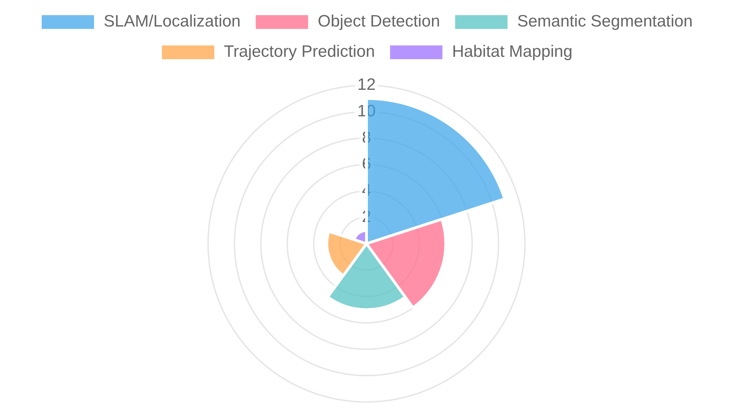






Dataset Synthesis: Common Modalities & Tasks
Prevalent Sensor Modalities
Common Task Domains
Lidar:
Dominant in outdoor/driving datasets (64-128 beams)
SLAM/Localization:
Most prevalent task across datasets
Universal across domains (stereo, RGB-D, panoramic)
Cameras:
Object Detection:
Common in driving/urban datasets
Trajectory Prediction:
Growing focus in autonomous systems
IMU:
Present in most datasets for motion estimation
Semantic Segmentation:
Increasingly common annotation
GPS:
Common in outdoor datasets for global positioning
Cross-Dataset Patterns
Increasing trend toward synchronized, calibrated multi-sensor setups
Multi-Modal Fusion:
Evolution from basic labels to multi-level semantic annotations
Annotation Richness:
Growing emphasis on revisiting locations over time (hours to years)
Temporal Coverage:
Datasets growing in size, duration, and environmental coverage
Scale Expansion:

Slide 14

















Dataset Synthesis: Identified Gaps
Underrepresented Modalities
Missing Task Domains
Almost entirely absent across datasets
Tactile/Haptic Sensing:
Few datasets for grasping, dexterous manipulation
Manipulation:
Only present in Waymo, underutilized for scene understanding
Audio:
Limited pairing of natural language with robot actions
Language-Action Grounding:
Thermal Imaging:
Rare despite utility in adverse conditions
Minimal data on collaborative tasks
Human-Robot Interaction:
Only in Zurich MAV, despite low-latency benefits
Event Cameras:
Most datasets feature static or slowly changing scenes
Dynamic Environments:
Force/Torque:
Missing despite importance for manipulation
Limited examples of robot failures or edge cases
Failure Cases:
Environmental & Contextual Gaps
Limited data in snow, heavy rain, fog, or extreme temperatures
Extreme Weather:
Few datasets in manufacturing, warehousing contexts
Industrial Settings:
Underrepresentation of nighttime or poorly lit environments
Low-Light Conditions:
Limited data in home settings with natural clutter
Domestic Environments:
Concentration in North America, Europe, limited Global South
Geographic Diversity:
Underrepresentation of off-road, wilderness environments
Unstructured Terrain:

Slide 15














Dataset Synthesis: Repurposing Opportunities
Cross-Dataset Fusion
Task-Specific Filtering
Combine KITTI's rich annotations with nuScenes' radar data
Multi-Modal Enhancement:
Extract revisited locations from Ford Campus and MIT Stata Center
Long-Term SLAM:
Merge Waymo's semantic maps with Ford Campus' long-term data
Cross-Domain Maps:
Create object-centric subsets from KITTI and Waymo
Multi-View Objects:
Combine datasets across weather conditions for invariant feature learning
Weather Robustness:
Extract low-light, rain, or glare sequences
Challenging Visibility:
Apply underwater sensing principles from ACFR to aerial datasets
Platform Transfer:
Extract ground surfaces from multiple datasets
Terrain Classification:
Novel Dataset Creation Opportunities
Pair robot-instructions with visual navigation from KITTI/nuScenes
Language-Grounded Navigation:
Add human activity annotations to indoor datasets
Human-Robot Collaboration:
Add force/tactile sensing to RGB-D 7-Scenes for manipulation
Tactile-Visual Dataset:
Curate challenging edge cases across datasets
Failure Case Library:
Augment existing datasets with spatial audio
Audio-Enhanced Perception:
Apply RGB-D 7-Scenes methodology to industrial settings
Industrial Task Dataset:

Slide 16






Exploring Robot Instructions Dataset
Dataset Overview
Instruction Types
Source:
milistu/robot-instructions on Hugging Face
Motion Commands:
Joint rotation, TCP positioning
Size:
887 training samples, test split available
State Queries:
Joint values, TCP position
Format:
Natural language input → Robot function call output
Compound Instructions:
Multiple actions in sequence
Focus:
Mapping language instructions to API calls
Phrasing Variations:
Different ways to request same action
Dataset Structure
Instruction Diversity
Input: "Move joint 3 to 90 degrees"
Output: [{"function": "move_joint",
"kwargs": {"joint": [2],
"angle": [1.5707963267948966]}}]
"Rotate joint 5 for 180 degrees"
"Move the robot TCP to position (0.05, -0.03, 0) meters"
Each sample maps a natural language instruction to one or more function calls with appropriate parameters.
"Please provide me with the status of all robot joints"
"Rotate robot base for 90 degrees and move TCP along y-axis for 100 cm"

Slide 17



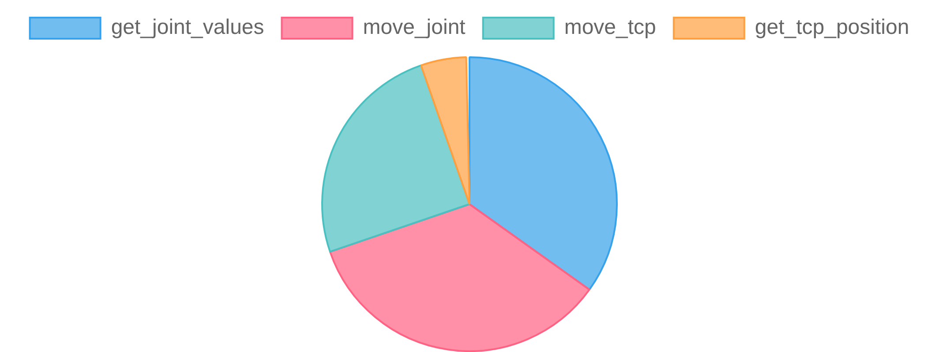
Robot Instructions: Language & Functions
Natural Language Variety
Function Mapping
Imperative Commands:
"Move joint 3 to 90 degrees"
Function
Purpose
Arguments
"Please provide me with the status of all robot joints"
get_joint_values
Retrieve joint angles
None (empty kwargs)
Conversational Requests:
move_joint
Rotate specific joint(s)
joint: [indices], angle: [radians]
"meters", "degrees", "radians", "mm", "cm"
Unit Specifications:
move_tcp
Position end-effector
x, y, z: millimeters
Compound Instructions:
"Rotate base and move TCP"
get_tcp_position
Get end-effector position
None (empty kwargs)
Function Distribution
Based on ~30 sample analysis, showing predominance of motion and state query functions.
Language-to-Function Examples
"Rotate joint 5 for 180 degrees"
"Move the robot TCP to position (0.05, -0.03, 0) meters"
[{"function": "move_joint", "kwargs": {"joint": [4], "angle": [3.14159...]}}]
[{"function": "move_tcp", "kwargs": {"x": 50.0, "y": -30.0, "z": 0.0}}]
"Give me robot joints info"
"Rotate robot base for 90° and move TCP along y-axis for 100 cm"
[{"function": "get_joint_values", "kwargs": {}}]
[{"function": "move_joint", "kwargs": {"joint": [0], "angle": [1.5707...]}}, {"function": "move_tcp", "kwargs": {"y": 1000.0}}]

Slide 18








Robot Instructions: Arguments & Units
Argument Structures
Value Ranges
Joint Indices:
0-based integers in lists (e.g., "joint 5" → [4])
TCP Coordinates:
Observed range from -700mm to 1500mm
Angles:
Always in radians, stored in lists
Joint Angles:
Full range (-π to π radians)
Coordinates:
Always in millimeters as floats
Joint Indices:
0-5 observed (6-DOF robot)
Structure:
Consistent use of "kwargs" dictionary
No Limits:
No explicit joint or workspace limits
Unit Conversions
Unit Conversion Examples
Input Unit
Output Unit
Conversion
"Move joint 3 to 90 degrees"
Degrees
Radians
× π/180
90° → 1.5707963267948966 rad
Meters
Millimeters
× 1000
"Move the robot TCP to position (0.5, 0.3, 0.7) meters"
Centimeters
Millimeters
× 10
0.5m → 500.0mm, 0.3m → 300.0mm, 0.7m → 700.0mm
"Move TCP along y-axis for 100 cm"
100cm → 1000.0mm
Implicit Assumptions & Potential Issues
Assumes 0-based indexing without explicit documentation
Joint Indexing:
Unclear if unspecified axes remain unchanged or default to zero
Partial Moves:
No explicit reference frame for TCP coordinates
Coordinate System:
No examples of impossible or ambiguous instructions
Error Handling:

Slide 19










Robot Instructions: Complexity & Gaps
Multi-Step Instructions
Ambiguities & Inconsistencies
Unclear if partial TCP moves are relative or absolute
"Rotate robot base by 45 degrees and move TCP along x-axis for 50 mm"
Relative vs. Absolute:
[
{"function": "move_joint", "kwargs": {"joint": [0], "angle": [0.7853981633974483]}},
{"function": "move_tcp", "kwargs": {"x": 50.0}}
]
Motion Planning:
No path constraints or collision avoidance
No validation of joint limits or workspace boundaries
Safety Checks:
Sequential Execution:
Multiple functions in ordered array
Timing:
No speed control or synchronization between actions
No Dependencies:
No conditional execution between steps
Limited Complexity:
Typically only 2-3 sequential actions
Missing Real-World Actions
No open/close/grasp functions
Gripper Control:
No emergency stop or force limiting
Safety:
No loops, conditionals, or waits
Program Flow:
No camera, force, or tactile feedback
Sensing:
No tool changing or TCP definition
Tool Management:
No coordinate system changes
Reference Frames:

Slide 20









Robot Instructions: Opportunities
Dataset Extension Opportunities
Multimodal Integration
Gripper Actions:
Add open/close/grasp with force control
Visual Context:
Pair instructions with scene images
Add vision-based instructions ("move to the red cube")
Perception Integration:
Add environment maps and object positions
Spatial References:
Program Flow:
Add conditionals, loops, and wait statements
Include force profiles for manipulation tasks
Haptic Feedback:
Add compliance modes, force limits, collision detection
Safety Features:
Dialogue:
Extend to multi-turn clarification dialogues
Template for Future Datasets
Clear function call structure with typed arguments
Structured Output Format:
Environmental context, error handling, safety constraints
Needed Improvements:
Consistent unit conversion between natural language and API
Unit Handling:
Expand beyond basic motion to full robot capabilities
Broader Function Set:
Multi-Step Actions:
Sequential execution of related commands
Include examples of clarification for underspecified commands
Ambiguity Resolution:

Slide 21










Conclusions & Actionable Insights
Key Findings: Robotics Datasets
Key Findings: Robot Instructions
Trend toward multi-sensor fusion and higher resolution
Modality Evolution:
Clear structure for converting natural language to API calls
Language Mapping:
Heavy focus on autonomous driving, less on manipulation
Domain Concentration:
Consistent conversion between human and machine units
Unit Handling:
Growing emphasis on long-term data collection
Temporal Coverage:
Focus on basic motion, missing many real-world actions
Limited Scope:
Datasets offer unique modalities that could be combined
Complementary Strengths:
Context Gap:
No integration with environmental perception
Actionable Insights for Future Dataset Creation
Create datasets that combine perception (from robotics datasets) with action (from instruction datasets)
Bridge the Modality Gap:
Develop datasets with clarification dialogues for ambiguous instructions
Multi-Turn Interaction:
Curate challenging scenarios from existing datasets to improve robustness
Edge Case Focus:
Develop instruction datasets for manipulation, perception, and human-robot interaction
Expand Function Coverage:
Create datasets that enable knowledge transfer between different robot platforms
Cross-Domain Transfer:
Create datasets where instructions reference objects in the environment
Contextual Grounding:

Slide 22


References
Robotics Datasets
mint-lab/awesome-robotics-datasets
- Curated list of robotics datasets
KITTI Vision Benchmark Suite
- Autonomous driving dataset
Waymo Open Dataset
- Autonomous driving dataset with lidar, camera, and audio
nuScenes Dataset
- Multimodal autonomous driving dataset
Zurich Urban MAV Dataset
- Micro aerial vehicle dataset
ACFR Marine Robotics Datasets
- Underwater robotics datasets
Ford Campus Vision and Lidar Data Set
- Autonomous driving dataset
Newer College Dataset
- Visual-inertial-lidar dataset
MIT Stata Center Data Set
- Indoor mapping dataset
RGB-D Dataset 7-Scenes
- Indoor relocalization dataset
Robot Instructions Dataset
milistu/robot-instructions
- Natural language to robot function call dataset
Additional Resources
Dataset Documentation:
Refer to individual dataset websites for detailed documentation, papers, and usage guidelines
Code Repositories:
Most datasets provide code for loading, visualization, and baseline methods
Benchmarks:
Many datasets maintain leaderboards for various tasks

